Slide 1


EDX AI/ML Python Data Science Bootcamp Project 1
Money miners: investment analysis

Slide 2

Our Mission Statement:
To Offer the best Investment advice and opportunities for our Clients!
We offer a unique value proposition to our clients by leveraging AI models to forecast the most probable future returns.
Notes:
Read the Mission

Slide 3

Executive Summary
Investment Opportunities in 2025
Scenario: While working for a large equity-trading company called Money Miners Inc, your client is unsure where they should invest: Bitcoin, Precious Metals (Gold), or a general S&P 500 Index Fund. We need to recommend which asset will yield the highest return in one year, and which asset is the riskiest investment.
Using various metrics from 2019 to 2024, Money Miners will analyze current prices and trends, and produce forecasts using the Google Prophet model.
Notes:
Read the scenario

Slide 4

questions to address:
What is the forecasted value of Bitcoin one year from now?
What is the forecasted value of Gold one year from now?
What is the forecasted value of an S&P 500 index fund one year from now?
Which investment would Money Miners recommend for the highest yield in 1 year.
Which investment would Money Miners recommend as the lowest risk to return on investment in one year?
Notes:
Now that we have our problem statement, we identified 5 questions that our analysis should answer: calculating the value in 1 year for each type of stock, determining which would have the highest yield and then which would be the lowest risk to return on investment.

Slide 5
Data Collection
Historic Bitcoin Prices
Historic Gold Prices
Historic S&P 500 Prices
Bitcoin prices, 2019-2024, with 2025 forecast.
Gold prices, 2019-2024, with 2025 forecast.
S&P 500 prices, 2019-2024, with 2025 forecast.
Investing.com:
https://www.investing.com/crypto/bitcoin/historical-data
Investing.com:
https://www.investing.com/commodities/gold-historical-data
NASDAQ.com:
https://www.nasdaq.com/market-activity/index/spx/historical
Notes:
We identified the 3 categories to collect data: Bitcoin, Gold and S&P500. The sources varied to find the most accurate data and we struggled finding free data with the speed we needed.

Slide 6
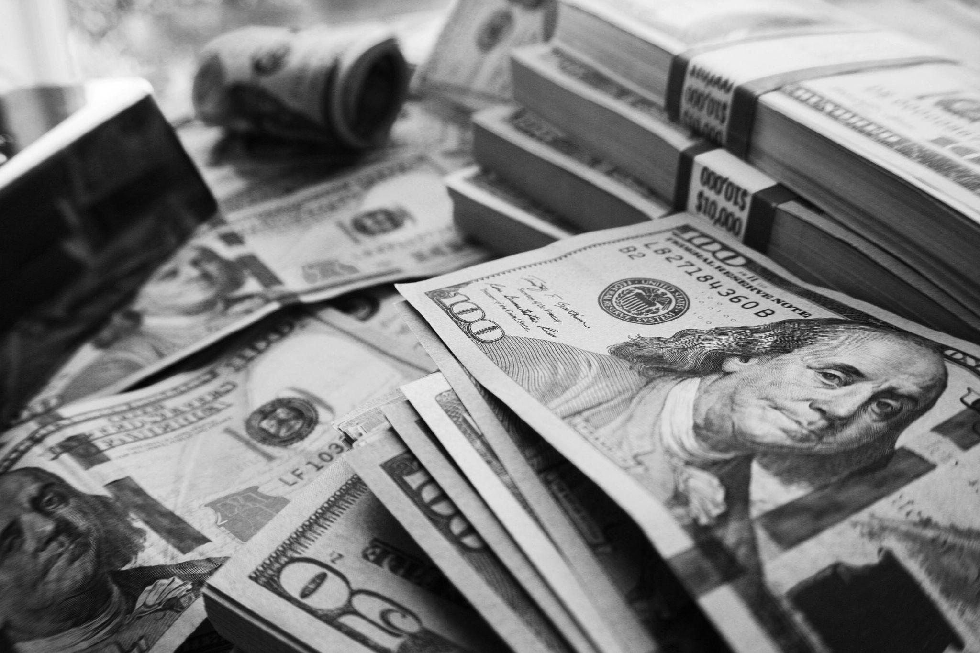
Data cleanup and exploration
1.
Common Data: We checked for common data and timeframes to clean our data.
For example: gold_df.columns = ["Price", "Open", "High", "Low", "Volume", "Change %"]
2.
Using Pandas and Python functions: We cleaned the data to remove characters like “K” for thousands, “M” for millions, and so on.
For example: creating a function def_convert_k_to_number
3.
To explore the data, we opted to curate and download the data instead of using Google’s built in finance function.
Notes:
To clean up the data and explore it, we focused on collecting data with common information by column and timeframe, how to use pandas and python functions to remove unclean values and explore how to return missing data such as google’s built in finance function.

Slide 7

Approach and methodology: how to quantify
Volatility
1.
Standard Deviation: A widely used measure of volatility, representing the dispersion or variability of returns from their average (mean). It provides a statistical estimate of how much an investment's returns can vary over time, helping to assess the risk associated with that investment.
2.
Average True Range: (ATR) is a technical analysis indicator used in financial markets to measure market volatility. ATR calculates the average range between the high and low price of an asset over a specified period, considering gaps in price movement.
3.
Beta: A measure of a stock's volatility relative to the overall market (commonly represented by a benchmark index like the S&P 500). It is a key concept in modern portfolio theory and is used to assess the systematic risk (market risk) of an individual asset or portfolio.
Notes:
Calculating the price over time was the easy part. Practically, it was easy to tell that Bitcoin would answer our first question of the highest return in 1 year for our client. We created a base notebook for bitcoin to compare price over time, calculate stock volatility and then visualize the differences graphically. We then copied this notebook for Gold and SP500 data and modified respectively for the differences in data. We still struggled with quantifying how volatile a stock was though. This is where we investigated Standard Deviation, Average True Range and Beta which we will explore in our recommendations.

Slide 8
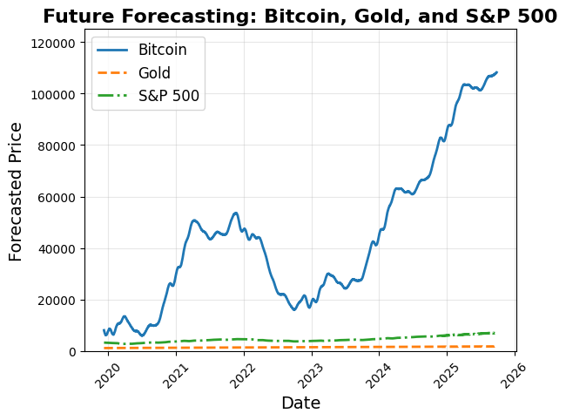
What is the forecasted value of Bitcoin 1 year from now?
The value of Bitcoin is forecasted to be $124,964.11 on 12/29/25 (ythat).
What is the forecasted value of Gold 1 year from now?
The value of Gold is forecasted to be $3460.33 on 12/29/25 (ythat).
Which fund would we recommend for lowest risk to return on investment in 1 year?
The lowest risk investment would be an S&P 500 index fund.
Notes:
Here are the results of the price comparison

Slide 9
What is the forecasted value of an S&P 500 Index Fund 1 year from now?
The value of S&P 500 is forecasted to be $7522.83 on 12/29/25 (ythat)
We would recommend Bitcoin for the highest yield at the end of the year!
Notes:
Here are the results of the price comparison

Slide 10
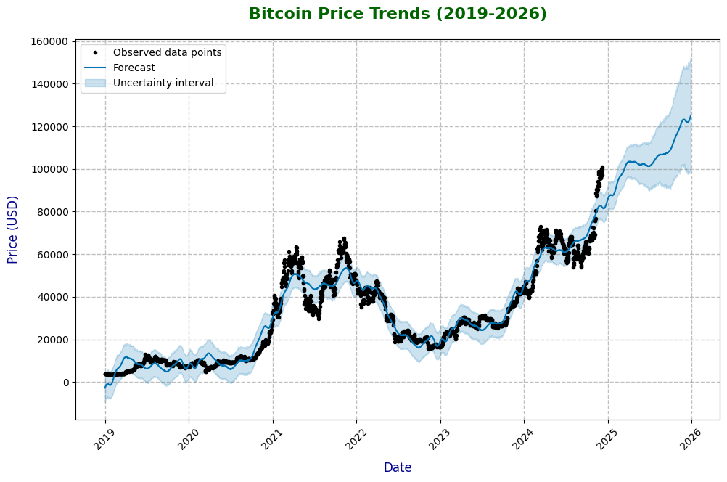
Bitcoin price Forecast
Upward Trend:
Bitcoin prices are expected to rise significantly through 2025.

Slide 11
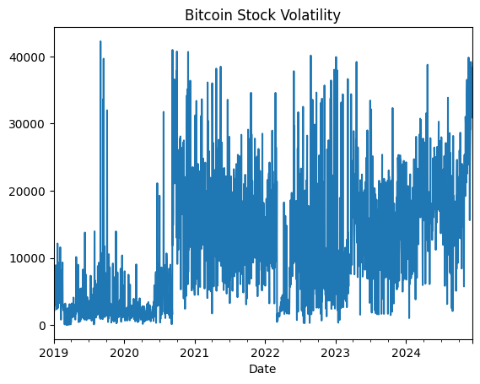
Bitcoin Volatility*
High risk, high reward.
Bitcoin is a very volatile asset, and can experience sudden (and sometimes) extreme fluctuations. However, while the volatility of this asset isn’t expected to improve, Bitcoin is expected to rise in 2025, as demonstrated in the previous graph.
Volatility*: Standard Deviation
Notes:
Bitcoin is influenced by small trades, leading to sharper price movements. Its decentralized and relatively young nature contributes to uncertainty, making it prone to both rapid surges and steep declines. This volatility creates opportunities for high returns but also carries substantial risk for investors.

Slide 12
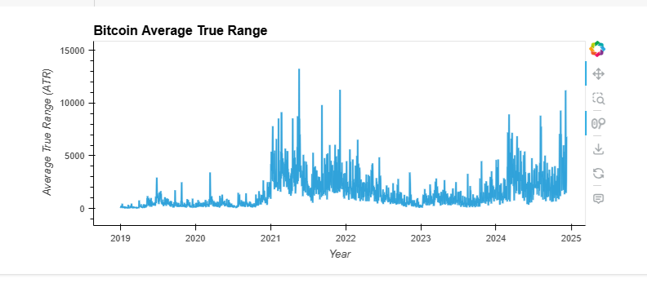
Bitcoin Volatility: Average True Range (ATR)
The average true range (ATR) is a price volatility indicator showing the average price variation of assets within a given time period. Investors can use the indicator to determine the best time for trading.

Slide 13
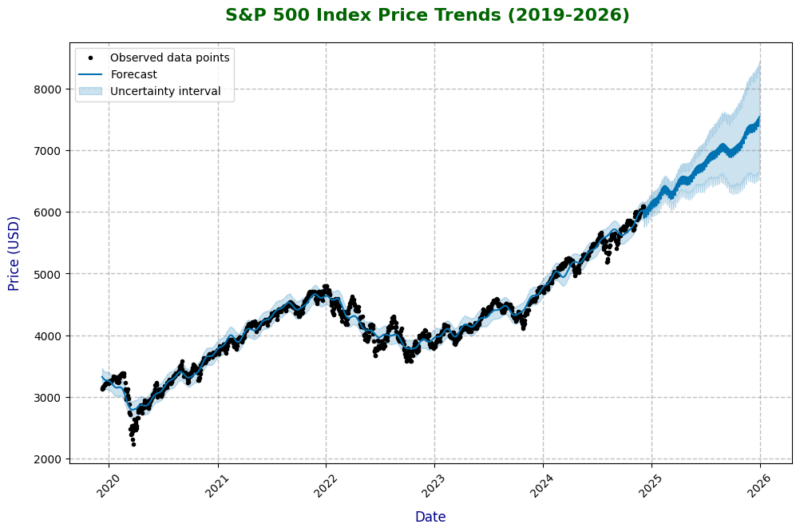
S&P 500 Performance and Forecast
The S&P 500 index price is expected to rise in 2025.

Slide 14
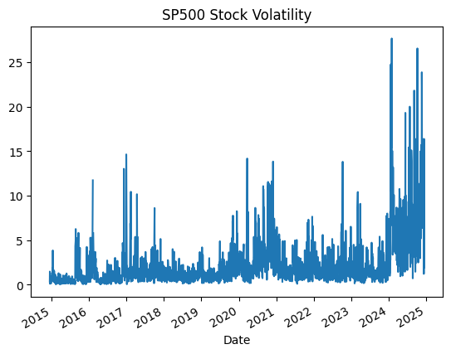
S&P 500 Volatility* and Forecast
The S&P 500 generally experienced moderate volatility, until 2024. It appears that the volatility is expected to continue in 2025.
Volatility*: Standard Deviation

Slide 15
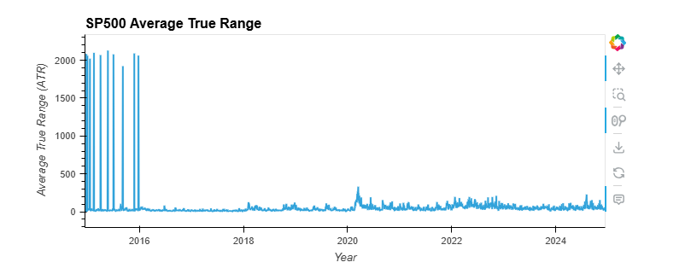
S&P 500 Volatility and Forecast: ATR
The average true range (ATR) is a price volatility indicator showing the average price variation of assets within a given time period. Investors can use the indicator to determine the best time for trading.

Slide 16
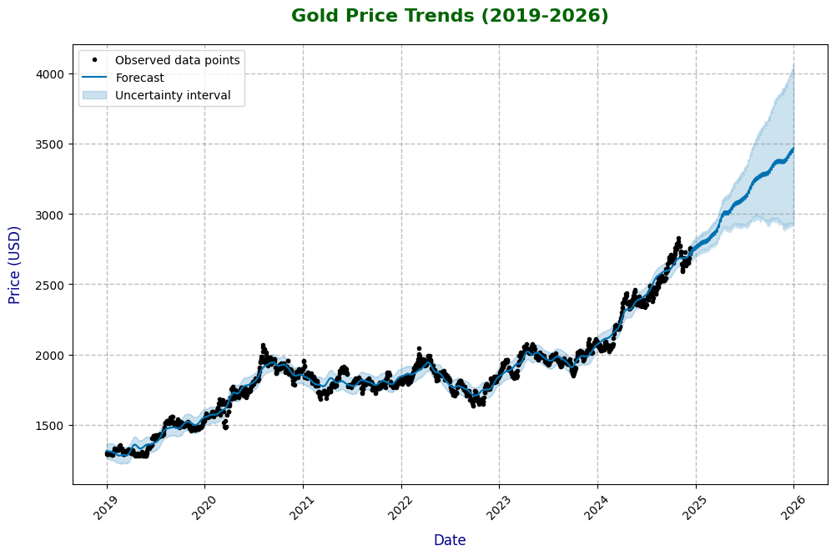
Gold prices and Forecast
The price of Gold is expected to increase significantly in 2025. Note that the lower-end of the forecast predicts a more modest increase in price.

Slide 17
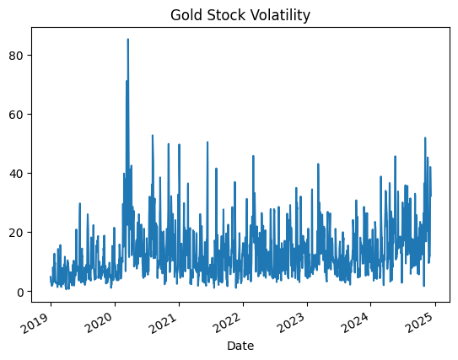
Gold Volatility* and Forecast
Gold generally experiences moderate volatility. Note the sharp increase in volatility as COVID-19 emerged in the Americas.
Volatility*: Standard Deviation

Slide 18
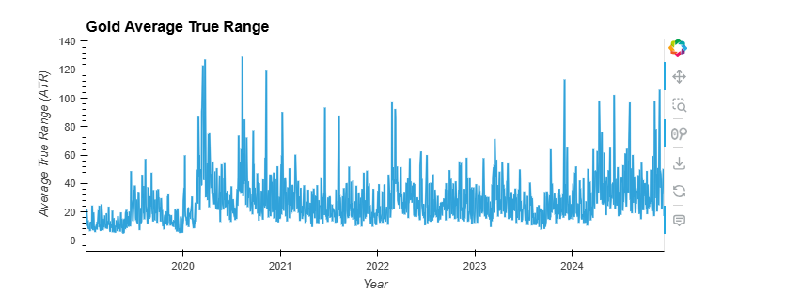
0.
Gold Volatility and Forecast: ATR
The average true range (ATR) is a price volatility indicator showing the average price variation of assets within a given time period. Investors can use the indicator to determine the best time for trading.

Slide 19
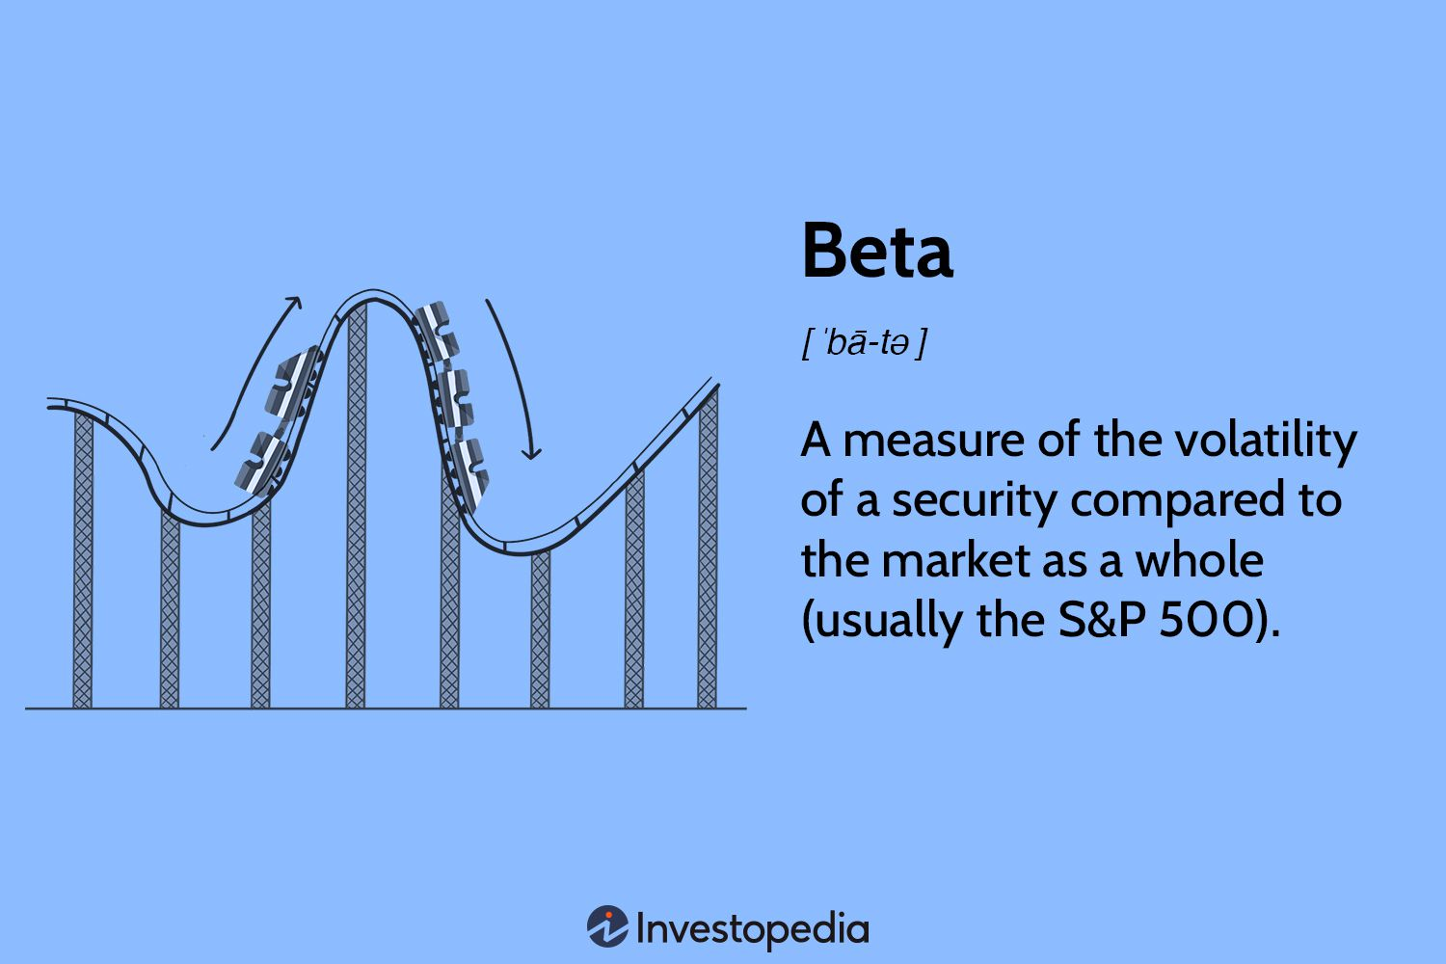
Volatility: Beta

Slide 20
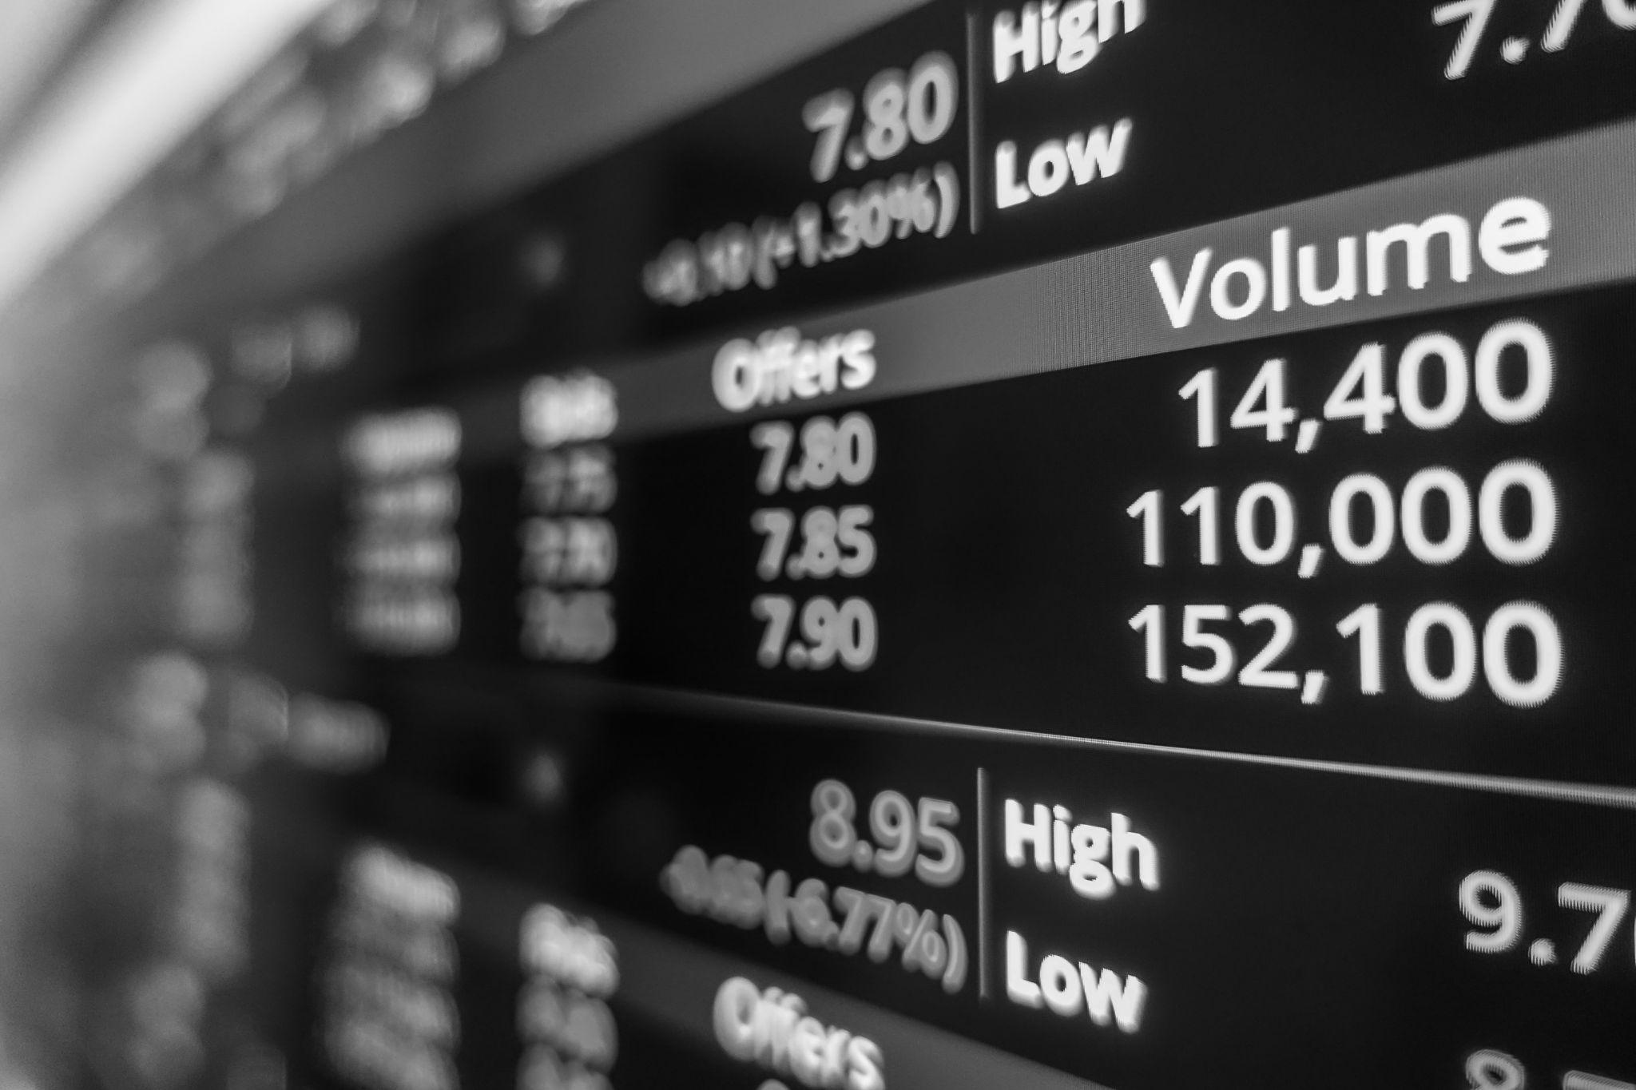
Volatility in relation to the S&P 500
Using the S&P 500 as a benchmark, we quantified the Beta values for Bitcoin and Gold, respectively. This will give our client a quantifiable value for what the riskiest stock is versus only examining stock volatility.
Beta of Bitcoin in relation to the S&P 500: 1.028
If Beta is greater than 1, the stock is more volatile than the market. Since the Beta for Bitcoin is 1.028 it’s more volatile than the market.
Beta of Gold in relation to the S&P 500: 0.072
If Beta is less than 1, the stock is less volatile than the market. Since the Beta for Gold is 0.072, it’s less volatile than the market.

Slide 21
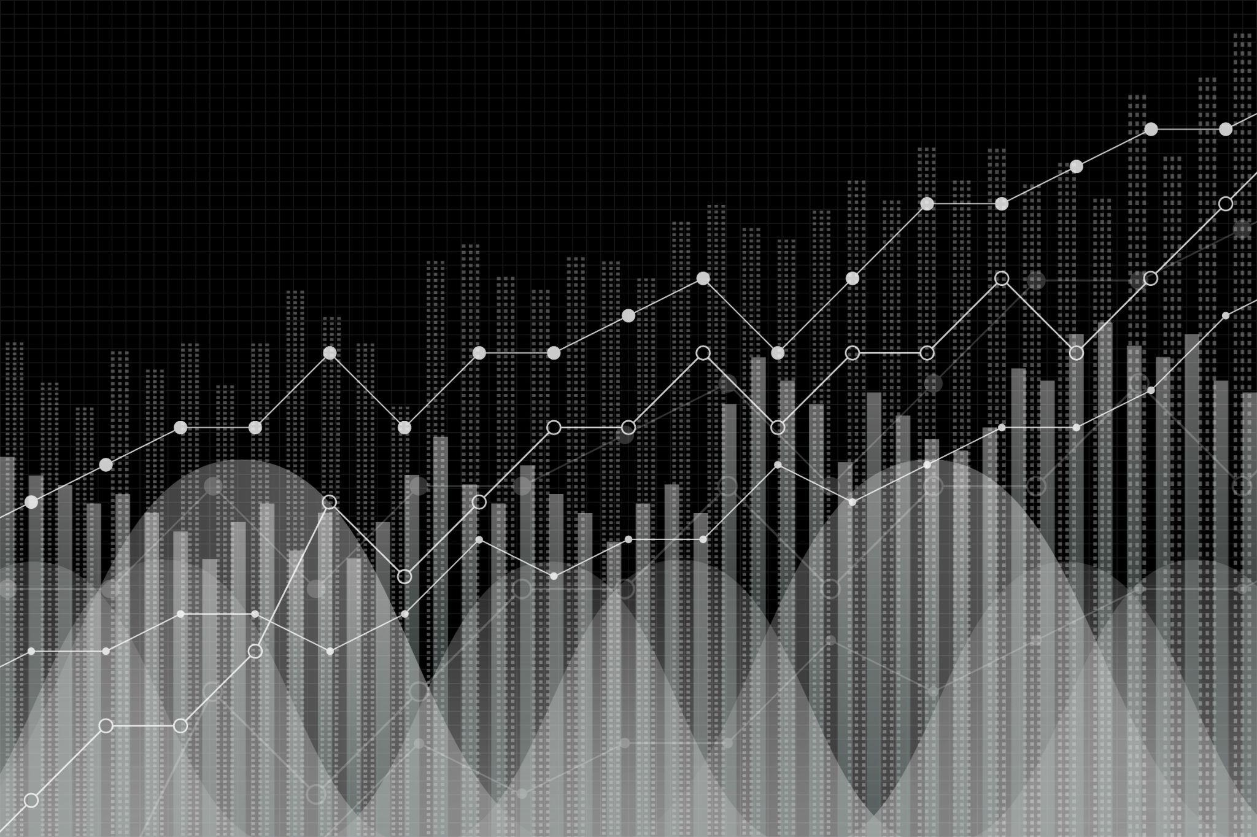
1.
Google Y Finance Google Finance is a financial data and analysis platform by Google. It provides users with tools to monitor stock prices, market news, and investment trends.
future research
2.
More Forecasting
We’d want to forecast investment returns over 3, 5, 10, and possibly 20 year periods.
3.
Research Different Coins, Metals, and Stocks
We’d look to research individual (bit)coins, other precious metals, and various individual stocks and funds.

Slide 22
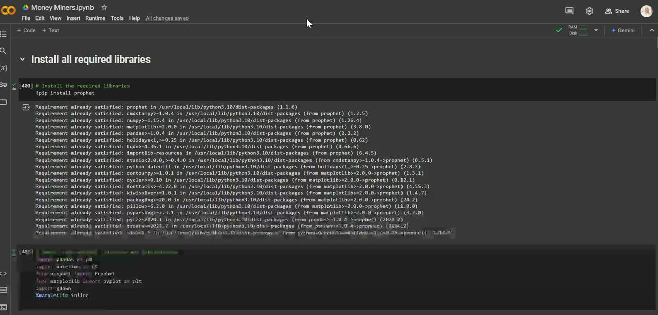
Money Miner Code

Slide 23

Thank you!
Thanks for your time!
Happy Investing!

Slide 24





Team Members
Katie Craig
Matthew Ward
Sowmya Shetty
Joel Freeman
Pablo Romero
Roderick Burroughs

